Slide 1

Password generator
Kadraliev Sardar Math20
Oop final project

Slide 2

Password generator
The main purpose of creating this type of program is to make a human live a bit easier. In terms of increasing number of hacking, it became so easily to explore personal data as well. It means that a measure of email accounts or accounts in any sites is in a big trouble.

Slide 3
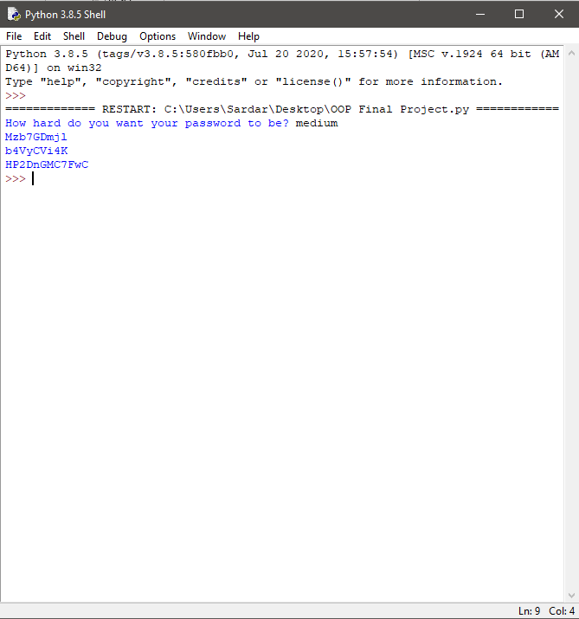
Password generator
Our Password randomizer is used to generate passwords, no matter what is required. It uses both letters(uppercase is also included) and numbers(from 1 to 9).
It means that you can use this in any site for singing up.

Slide 4
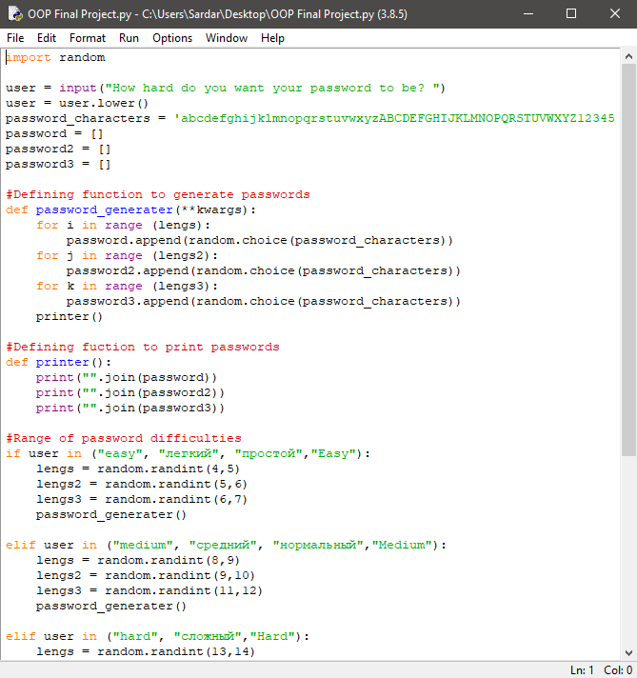
Password generator
During the work process we developed the ability to generate passwords of any complexity.
The templates will help you choose a password according to the criteria of the site on which you are going to register.

Slide 5
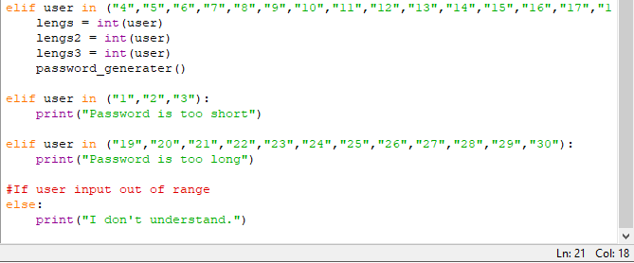
Password generator
We also included a function to generate a password according to the numbers of the characters.
It means, if you write the number of a characters it would show you only n-sized passwords.
Example:
-19
-FJgldl4ldkal2dwqeo3

Slide 6
Complexity levels
EASY
4-7 CHARACTERS
MEDIUM
8-12 CHARACTERS
HARD
13-18 CHARACTERS

Slide 7
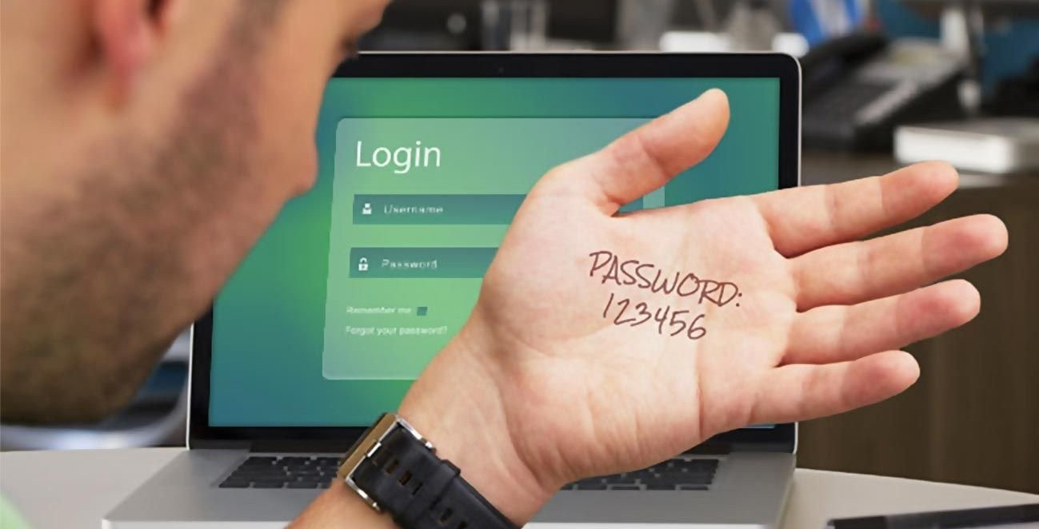
Password generator
More than a billion lines with logins and passwords were analyzed and it turned out that about 7 million lines were with the password "123456". According to the specialists, this "password" has been the most common among users over the past five years.

Slide 8
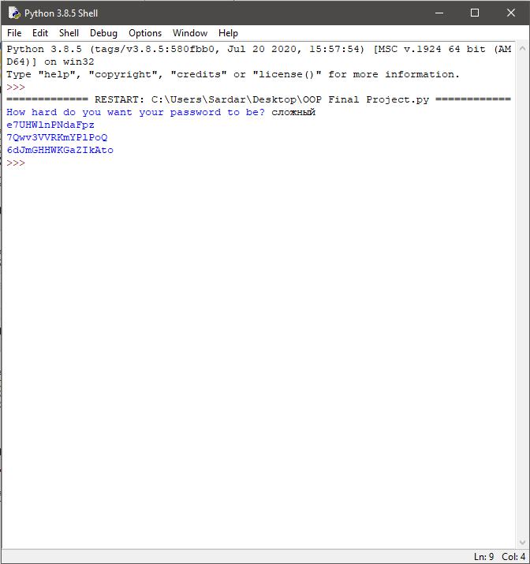
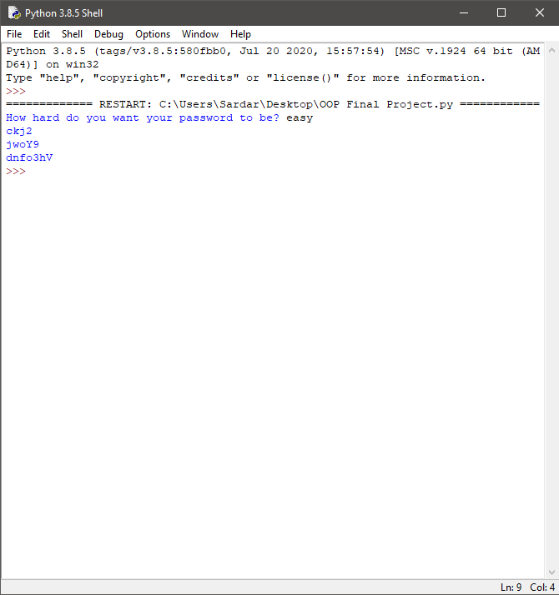
Password generator

Slide 9
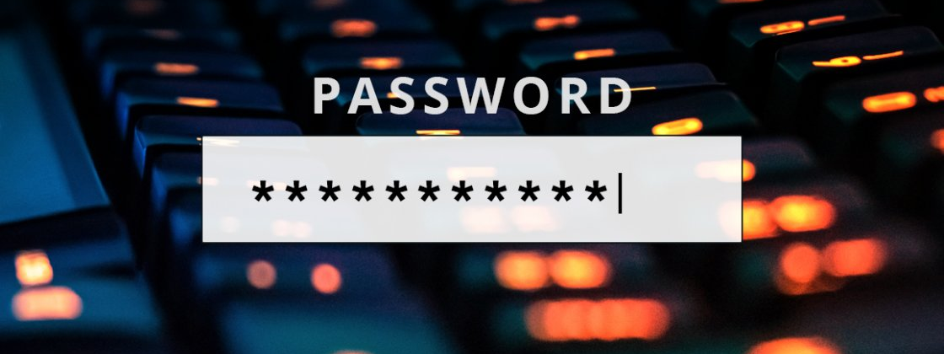
Thanks for attention!
https://github.com/semakalnin/Password-Randomizer-of-Any-Complexity

